Slide 1

Regional Field Training Hub

Slide 2

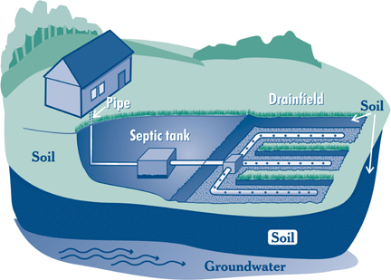

Regional Field Training Hub
Purpose: To enhance the existing local public health infrastructure where local public health professionals, specifically inspectional staff, will receive standardized, hands-on competency training in the areas of housing, food, and septic/wastewater.
Goal: To ensure that local public health inspectional staff provide consistent inspections based on the state standards.

Slide 3
Background
In its 2006 report, Strengthening Local Public Health in Massachusetts: A Call to Action , the Massachusetts Coalition for Local Public Health (CLPH) recommended “strengthen(ing) workforce development and competency through increased training opportunities for local boards of health and staff and through the development of minimum educational levels and credentialing for certain positions”.
The Local Public Health Institute of Massachusetts Competency Report (2010) identified inter-disciplinary, cross-cutting competencies and program area competencies for the local public health workforce. These competencies have guided the development and delivery of training programs for the local public health workforce.

Slide 4

Recommendations of the Special Commission:
Elevating the standards by:
  Identifying ways for cities & towns to meet statutory requirements
  Assessing implementation of Foundational Public Health Services
Strengthening service delivery by:
  Increasing the number and scope of comprehensive public health districts
Improving data reporting by:
  Creating a standardized public health reporting system
  Strengthening DPH, DEP, and local public health capacity to collect and share data
Setting education and training standards by:
  Making training accessible
  Implementing workforce credentialing standards adopted by SCLRPH
  Developing a system to ensure compliance
Committing appropriate resources to implement the above recommendations
*Consensus finding and recommendations: Special Commission on Local and Regional Health

Slide 5
Requirements
Provide the structure and capacity to implement field training in the areas of environmental health inspection, including housing/community sanitation, food protection and Title 5/wastewater.
Maintain up-to-date documentation of the shared service arrangements (SSAs) contacts designated covered by your FTH.
Collaborate with the SSAs that make up your FTH structure.
Maintain up to 4 full-time equivalent trainers to provide field training on environmental health, including housing inspections, other community sanitations inspections, food inspections, and Title 5/wastewater. Provide a justification for the trainer numbers and types you need for your hub, based on assessment of need. Each trainer should be paid no less than $70,000/annually with benefits $87,000.
Maintain a minimum of a 0.5 FTE Non-Trainer Coordinator position, who is responsible for supporting trainers with registration, coordination of trainings and trainees, coordination with the OLRH Senior Coordinator for Field Operations and the state Central Trainers.
Commit to ensuring diversity of trainers, minimally representing the diversity of the region.
Demonstrated capacity to provide supervision and support of field trainers.

Slide 6
Requirements
Provide timely quarterly narrative (data on trainers, trainees, and trainings) and expenditure reports in a format and method provided by OLRH. Quarterly narrative and expenditure reports must be received in a timely manner in order for OLRH to process quarterly payments. If a FTH grantee anticipates a delay in submitting quarterly reports, they must submit a request for an extension to the Senior Coordinator for Field Operations. If reporting is delayed more than two months past the deadline, OLRH will not be able to process that quarterly payment.
Attend required meetings with OLRH Workforce Development lead staff.
Submit full, detailed workplans and budgets for FY25 by the deadline established by OLRH at the end of FY24. Workplans and budgets must work towards finding sites for field training, how you will track trainers, and share announcements with SSAs on available training. Ensuring that there is equitable access to trainings in the PHE regions.
Logistical management of having field trainers participate in DPH Training of field trainers.
Work with the Senior Coordinator in collaboration with LPH partners and other DPH programs to ensure alignment, to revise field curricula when necessary, and to decrease duplication as well as to acquire feedback about the FTH model. Seek prior approval from OLRH for changes in the proposal and use of funding. All work performed pursuant to this contract is subject to review and approval of the Department prior to any public release of said work. If a selected vendor performs any work through agents, subcontractors, assigns, or the like, all such work shall be subject to the terms of this contract. This includes but is not limited to publications and presentations.
Collaborate with OLRH and state Central Trainers in sharing resources to FTH professionals on DPH standardized curricula for field training.

Slide 7
Requirements
Work with the state Central Trainers to ensure standardization of the training protocols and standard curricula; utilize DPH curricula.
Work with OLRH Workforce Development Unit on using the new learning management system TRAIN.
Grant funds can be used for staff salaries, benefits, payroll taxes, support staff, consultants, travel, health communication, applicable technology hardware and software, training and credentialing for the field trainers, inspection supplies, membership fees, and occupancy, as outlined by the “Field Training Hubs: FY24 Allowable Expenses,” document. The primary purpose of this procurement is to expand local public health capacity to provide more field training opportunities to PHE professionals in the areas of community sanitation, food protection, and Title 5/wastewater. Funds cannot be used for equipment without prior written approval from DPH. Use of funds for capital expenses are not allowed; special requests may be considered by DPH, and decisions will be communicated in writing. Funds cannot be used to supplant existing municipal funding for public health services.

Slide 8
Allowable Expenses:
Budget Line Item Category | Training Hub Allowable Activities
Training Hub Staff: 4 FTE Hub Trainers (staff or contractors) for housing, other areas of the sanitary code, food protection, and septic/wastewater | Staff funded by the contract and their associated fringe benefits/payroll taxes. Municipal funds cannot be supplanted.
Support Staff: .5FTE Administrator/Clerk Health Directors/Managers percentage of time for oversight | Staff time for expanded duties related to the Training Hub and associated fringe benefits/payroll taxes. Municipal funds cannot be supplanted.
Travel | Mileage reimbursement for Training Hub-funded staff to complete day-to-day training activities. Please keep records of mileage for auditing purposes. Travel costs related to training and CEUs for the Hub Trainers to maintain workforce credentials outlined in the Blueprint (page 61). Travel costs for training may include mileage and lodging using current Federal GSA rates. Travel costs related to training must not exceed $750 per FTE per year, for up to 5 FTEs. **OUT OF STATE TRAVEL IS NOT ALLOWED UNDER THIS CONTRACT**

Slide 9
Allowable Expenses:
Budget Line Item Category | Training Hub Allowable Activities
Training Materials/Job Aids | Creating and/or duplicating materials and job aids to support the hand-on trainings and trainees. Materials should be shared with the Senior Trainers to standardization and ability to share best practices across the Training Hubs.
Technology Hardware | Technology necessary to support the Training Hubs and Regional and Administrative staff: Computers, laptops, iPads, tablets, headsets, speakers, microphones, earbuds, monitors, recording equipment, translation equipment, keyboards, and cell phones.
Technology Software | Software that supports the goal of hands-on inspectional training of PHE staff. (Prior to purchasing inspectional or permitting software to use as part of hand-on training, OLRH and/or Senior Trainers should be consulted.)

Slide 10
Allowable Expenses:
Budget Line Item Category | Training Hub Allowable Activities
Training and Credentialing | Training and credentialing for the Hub Trainers and clerical staff: ▪ To acquire the workforce credentials outlined in the Blueprint (page 61). This excludes academic programs such as associates, bachelors, masters, and doctoral programs. ▪ For CEUs and contact hours to maintain workforce credentials outlined in the Blueprint (page 61) ▪ For educational materials such as credentialing exam study guides ▪ For exam fees required to attain credentials ▪ For registration fees to participate in training courses, when relevant to a staff member’s responsibilities, from organizations including, but not limited to: ▫ Health Resources in Action ▫ Local Public Health Institute ▫ Massachusetts Association of Health Boards ▫ Massachusetts Association of Public Health Nurses ▫ Massachusetts Public Health Association ▫ Massachusetts Health Officers Association ▫ Massachusetts Environmental Health Association ▫ NEIWPCC ▫ Western Massachusetts Public Health Association (OLRH may request support of the Training Hub to cover registration for specific training for PHE staff.) Expenses CANNOT supplant existing training funds.

Slide 11
Allowable Expenses:
Budget Line Item Category | Training Hub Allowable Activities
Inspection Supplies | Supplies needed for the hands-on inspectional training of PHE staff. Examples of such supplies include thermometer, moisture meter, handheld blacklight/flashlight, PH meter, test strips, pool test kit, etc.
Membership Fees | Professional membership fees for MA-based organizations related to work in local public health, for the Regional Trainers. Organizations include: • Massachusetts Association of Health Boards • Massachusetts Association of Public Health Nurses • Massachusetts Public Health Association • Massachusetts Health Officers Association • Massachusetts Environmental Health Association • Western Massachusetts Public Health Association
Occupancy | Program space for training staff (being fully remote is allowed except for when conducting training) and costs related to logistics of securing a training site. Examples of Training Hub occupancy-related expenses include renting of office space, purchasing an office chair, annual fee for a Training Hub staff building security key card or pass code, Xerox leasing fee, etc.

Slide 12
Allowable Expenses:
Budget Line Item Category | Training Hub Allowable Activities
Agency Admin Support | Agency administrative support fee This fee is up to 15% of the contracted amount of funds and supports the organization in covering everyday costs for overall contract administration, including but not limited to: phone service, internet service, general office supplies, IT support, accounting support, payroll, human resources, management, and supervision. The total agency administrative support fee cannot exceed 15% of the total contracted amount of funding. Please consult with the Senior Field Operations Coordinator or Director of Workforce Development, OLRH, if your municipality or entity requires a different %.

Slide 13
Unallowable Expenses:
Unallowable Training Hub Expenses | Examples
Supplanting existing municipal funding for public health services | Using Training Hub funds to support the salary of a staff or contractor that is also being paid at the same time by tax levy or other grant funding.
Purchasing a vehicle | Purchasing a vehicle
Capital expenses, including any office buildouts to accommodate staff. If you have specific questions about what qualifies as a capital expense, please contact DPH. | Constructing walls for a new office, purchasing a trailer to hold supplies
Airfare or any out-of-state travel or lodging | Purchasing a flight to a conference, reimbursement for mileage for a conference that took place out of state.
Equipment (only allowable with prior consent from DPH) | Purchasing a new generator for a municipal building or for the organization
Academic programs such as associates, bachelors, masters, and doctoral programs | Paying the tuition for a course that offers undergraduate or graduate credit
Multiyear Service Payments | A contract for Software services paid upfront that extends past the contract period.

Slide 14
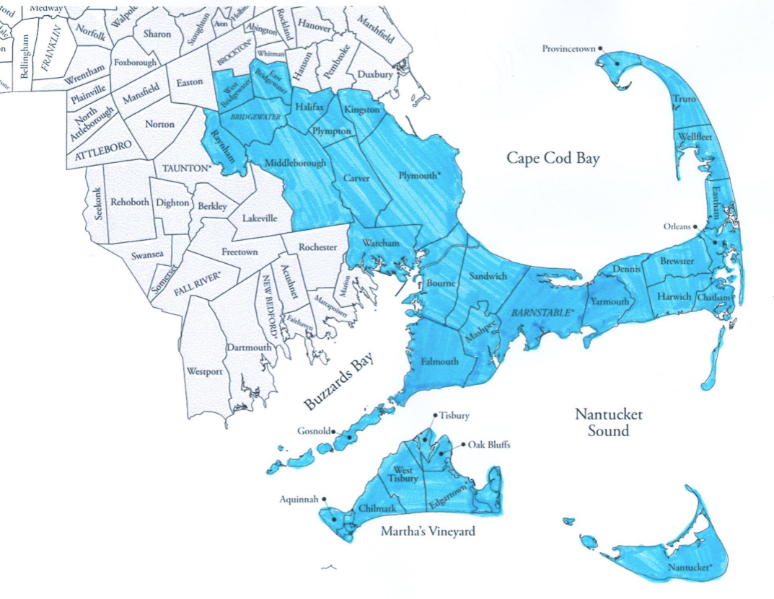
List of all towns included in the Training Hub:
  Barnstable:
  Barnstable
  Bourne
  Brewster
  Chatham
  Dennis
  Eastham
  Falmouth
  Harwich
  Mashpee
  Orleans
  Provincetown
  Sandwich
  Truro
  Wellfleet
  Yarmouth
  Nantucket:
  Aquinnah
  Chilmark
  Edgartown
  Gosnold
  Nantucket
  Oak Bluffs
  Tisbury
  West Tisbury
  Halifax:
  Bridgewater
  East Bridgewater
  Halifax
  Middleborough
  Raynham
  West Bridgewater
  Kingston:
  Carver
  Kingston
  Plymouth
  Plympton
  Wareham

